Slide 1

Human Resource Management
Presented by:
Ankush Sharma
Rakesh Sahani
Himanshi
Sachin Gogna

Slide 2
CONTENT
Introduction
Objective
Scope
Hardware and software requirement
Modules
Block diagram
E-R diagram
Dfd
Use case
Interfaces

Slide 3
INTRODUCTION
Human resource management (HRM, or simply HR) is a function in organizations designed to maximize employee performance in service of their employer’s strategic objectives. HR departments and units in organizations are typically responsible for a number of activities, including employee recruitment, training and development, performance appraisal, and rewarding (e.g., managing pay and benefit systems).

Slide 4
OBJECTIVE
To concentrate all the human resource work on a one web application .
Allow access to only authorized person.
To create/update all employees Information .
To generate general Information of employee example pay slip, no. of working days.
Mark attendance of the employee present on that particular date using unique employee id.
Allocation of project to the employee

Slide 5
SCOPE
The future looks quite good for organizations but it has been true, it will be good for enhanced productivity fully utilizing the combined talent and skills of the entire workforce of an organization. HRM must today reinvent itself to cope with the demands of a global economy.

Slide 6
HARDWARE AND SOFTWARE REQUIREMENT
HARDWARE
SOFTWARE
Processor : X86 Compatible processor with 1.7 GHz Clock speed
RAM : 512 MB or more
Hard disk : 8 GB
Monitor : VGA/SVGA
Keyboard : 104 Keys
Mouse : 2 buttons/ 3 buttons
Operating System : Windows 2000/7/8/XP/VISTA
Front end : JSP
Back end : MySQL

Slide 7
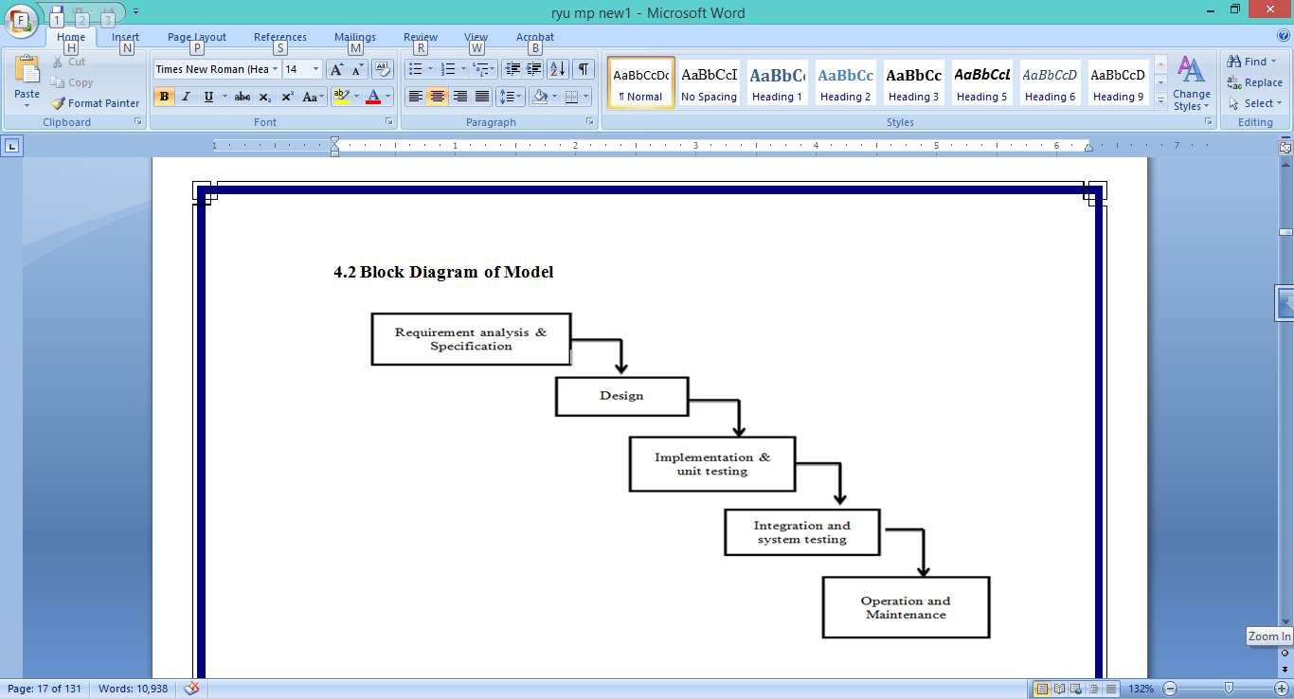
WATERFALL MODEL

Slide 8
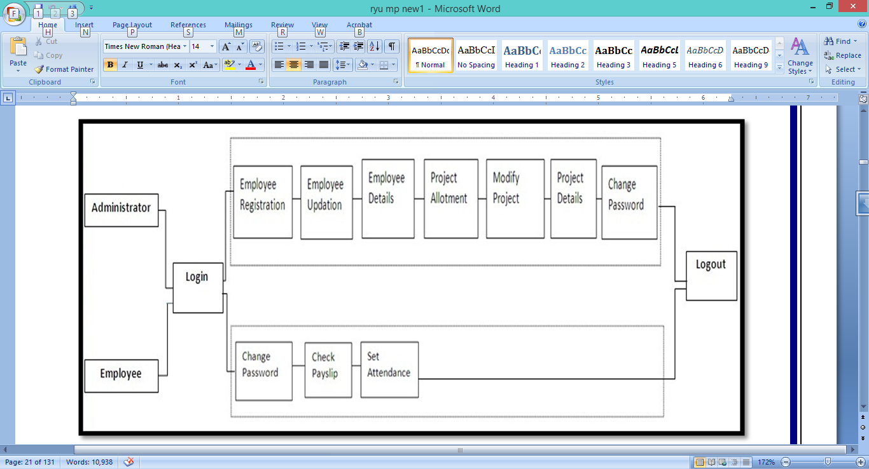
BLOCK DIAGRAM OF PROJECT

Slide 9
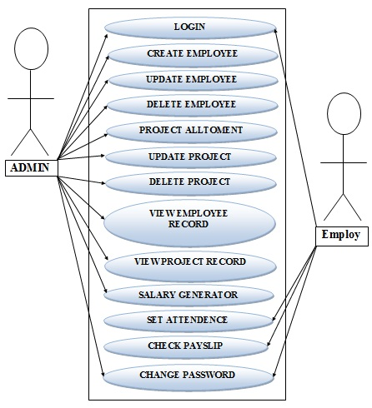
USE CASE

Slide 10
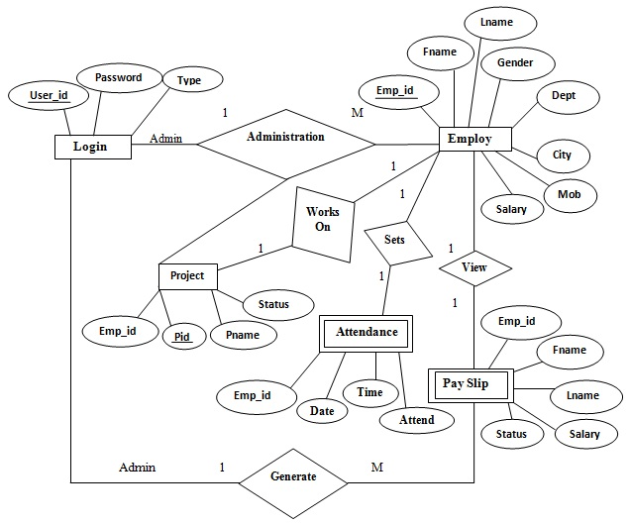
E-R DIAGRAM

Slide 11
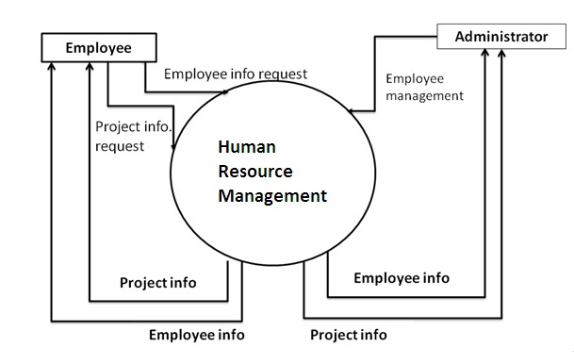
Dfd level-0

Slide 12
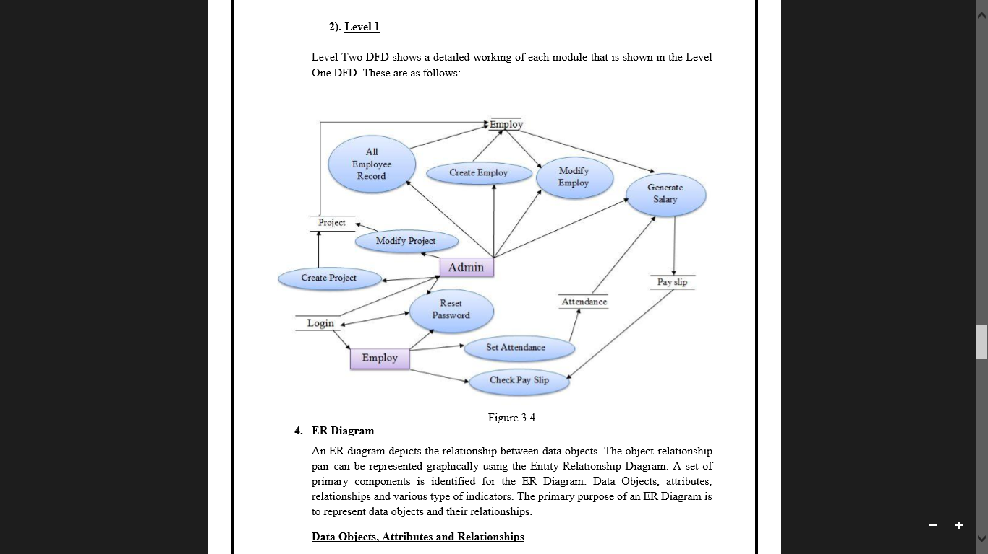
DFD LEVEL-1

Slide 13
modules
Modules of admin
Administrator
Login
Update Employee Records
Create Employee
Delete Employee
Project Allotment
Update Project Allotment
Delete Project
View Employee Record
Pay Slip Generation
Reset password
Logout
Modules of employee
Employee
Login
Set Attendance
View Pay slip
View Project
Reset Password
Logout

Slide 14
Interfaces

Slide 15
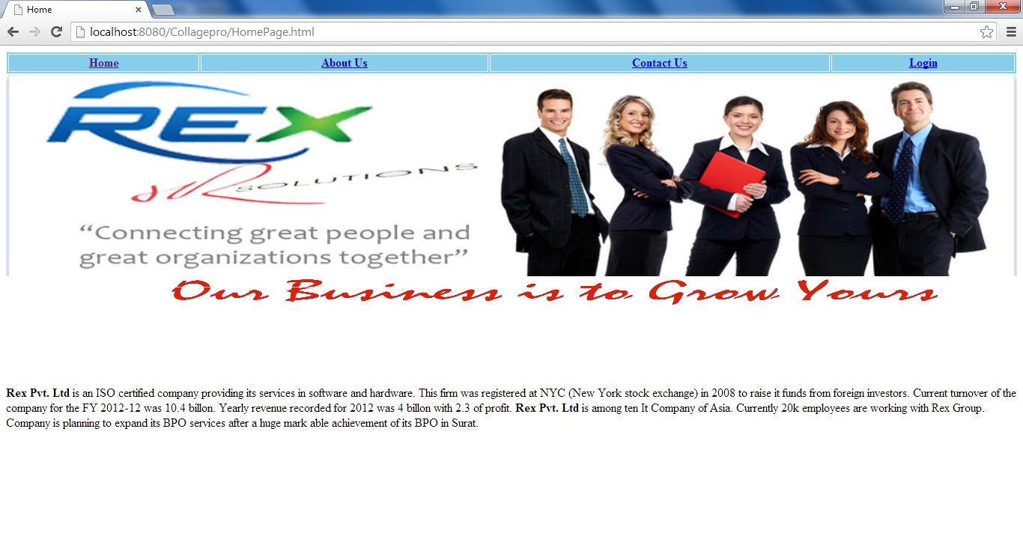
HOME PAGE

Slide 16
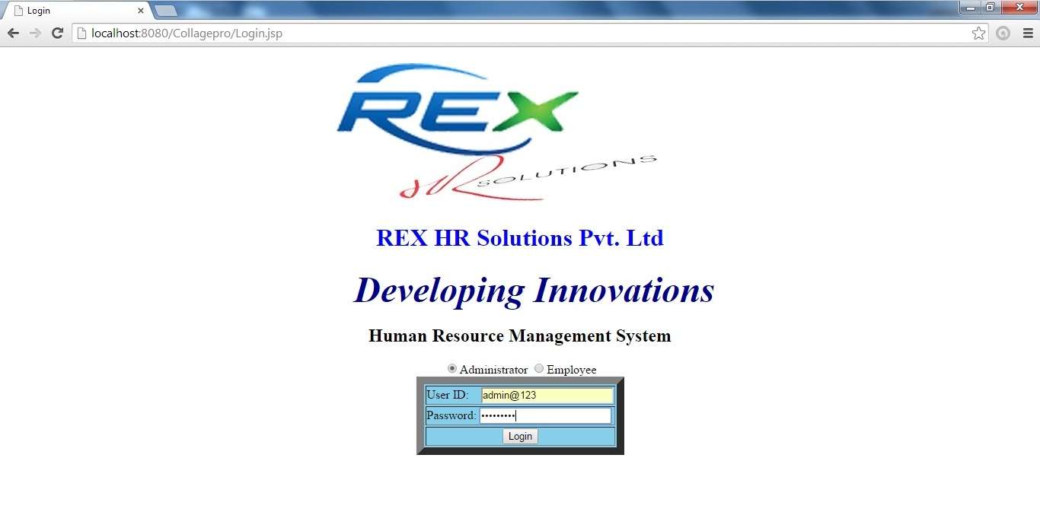
LOGIN PAGE

Slide 17
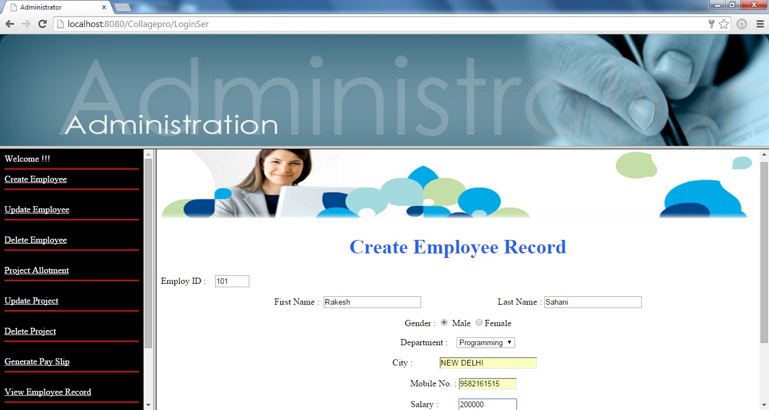
CREATE EMPLOYEE

Slide 18
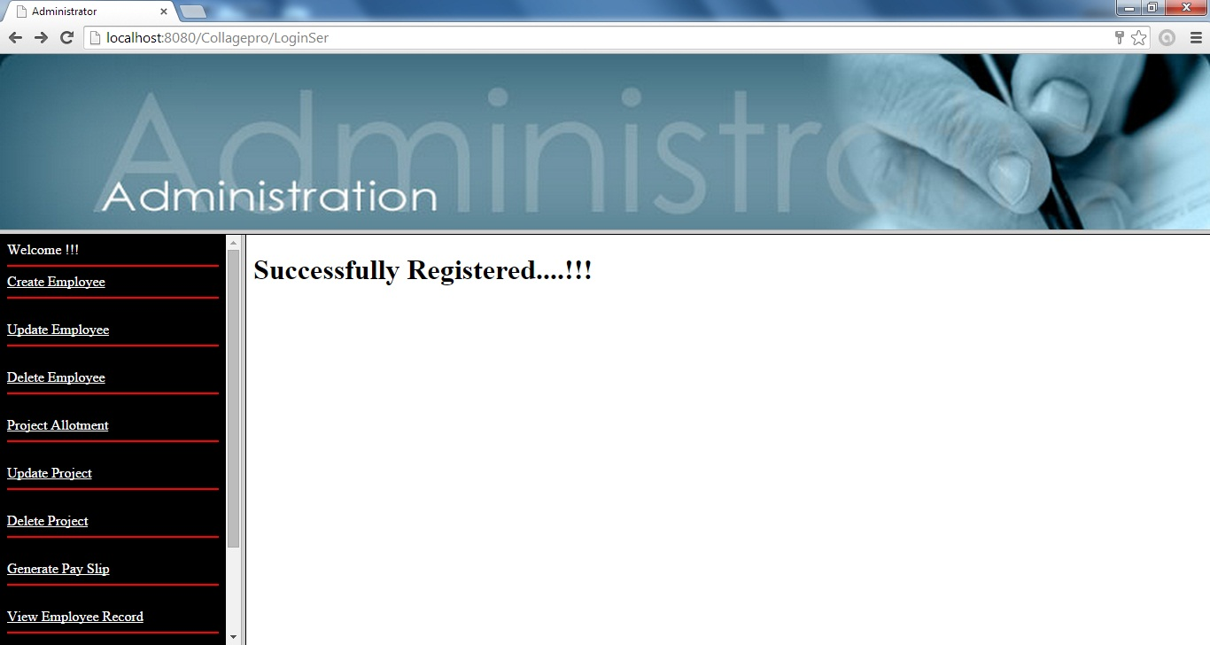
CREATE EMPLOYEE

Slide 19
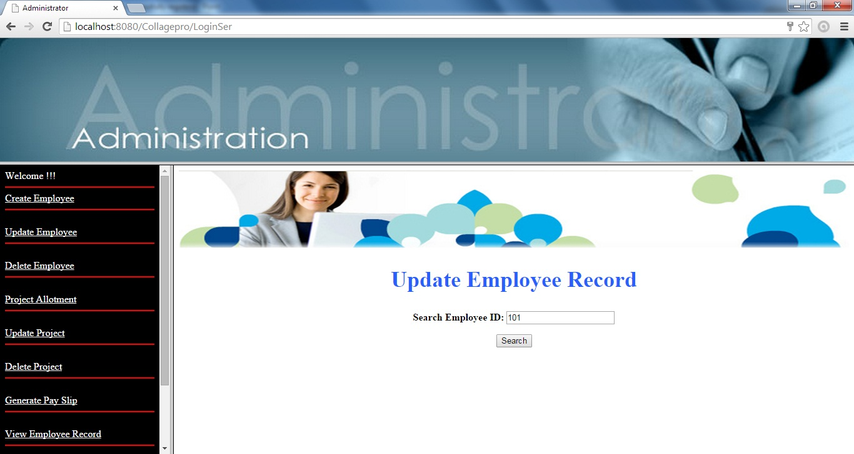
UPDATE EMPLOYEE

Slide 20
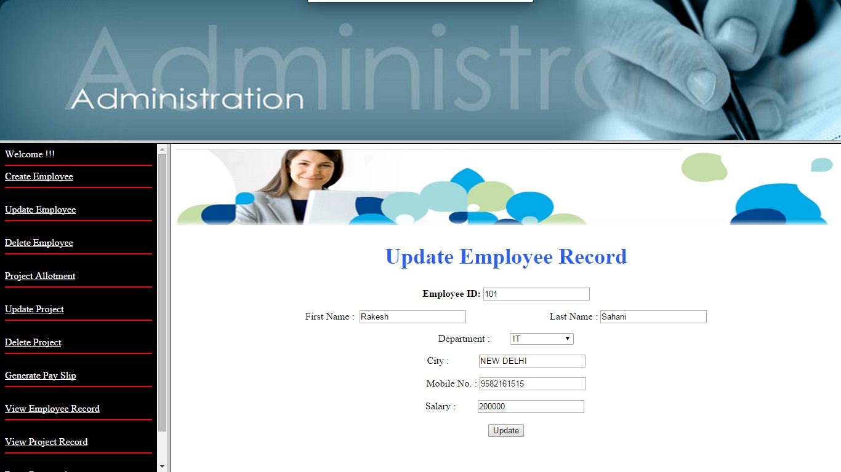
UPDATE EMPLOYEE

Slide 21
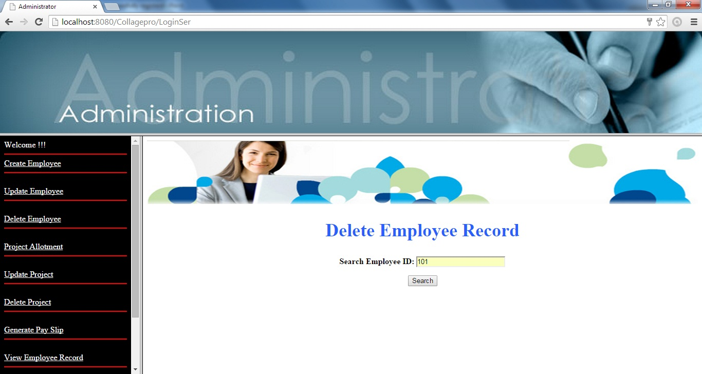
DELETE EMPLIOYEE

Slide 22
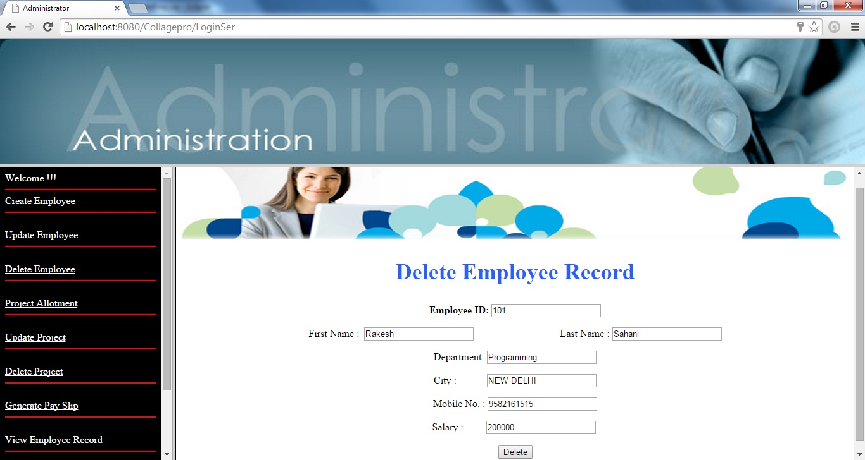
DELETE EMPLIOYEE

Slide 23
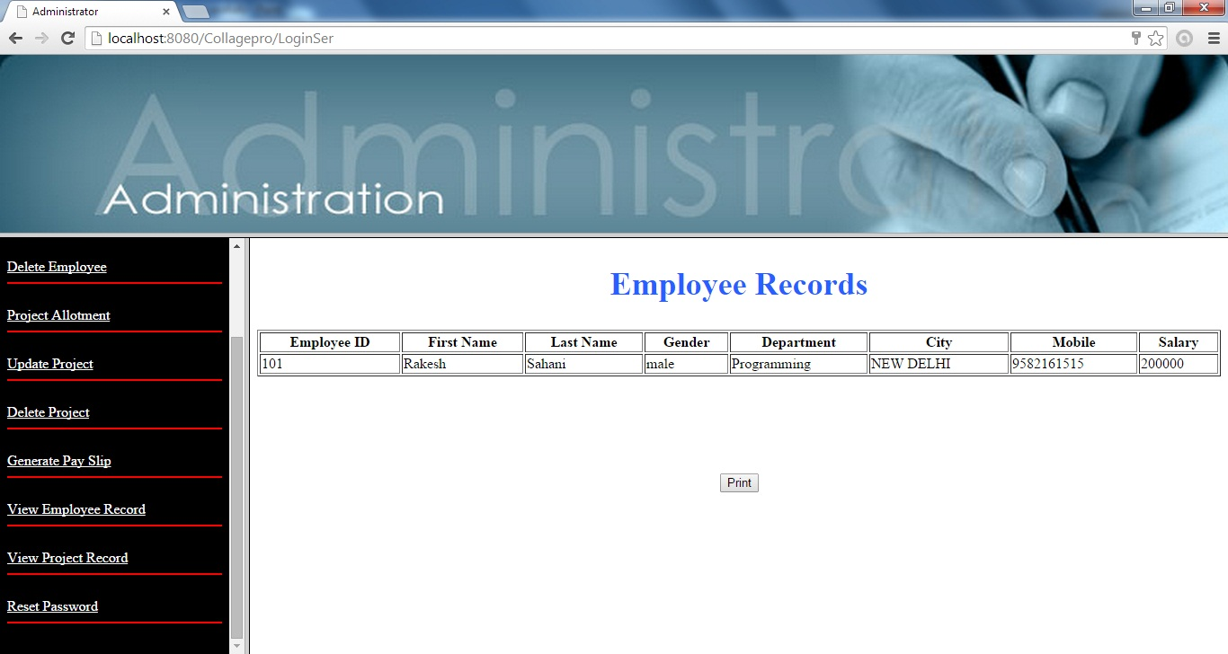
VIEW EMPLOYEE RECORD

Slide 24
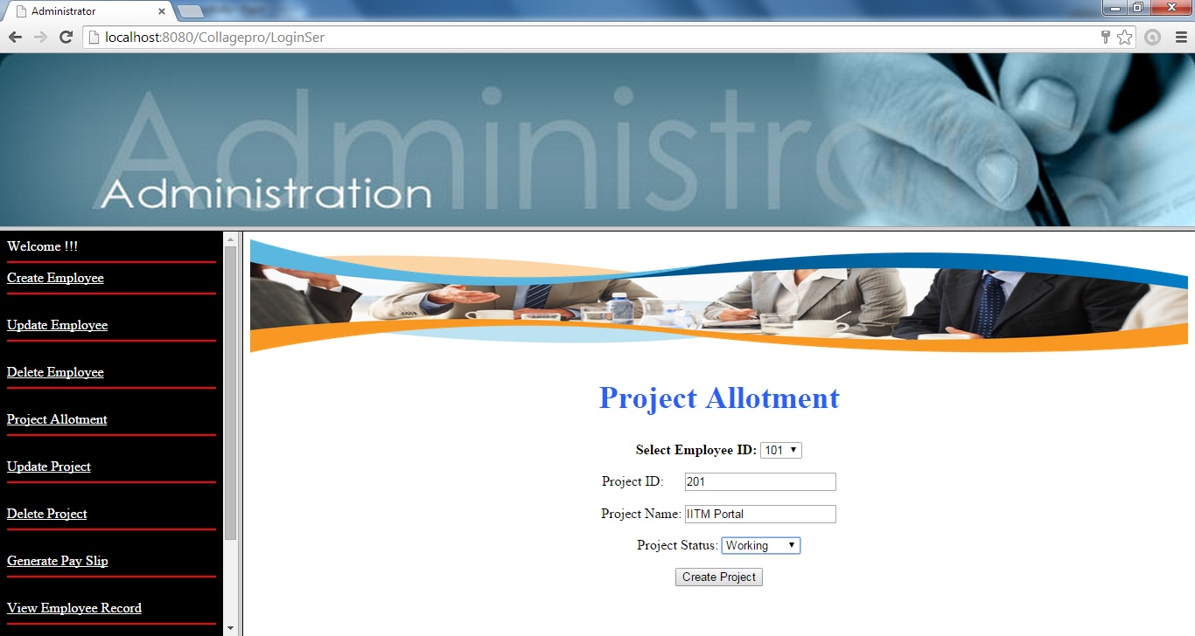
PROJECT ALLOTMENT

Slide 25

UPDATE PROJECT

Slide 26
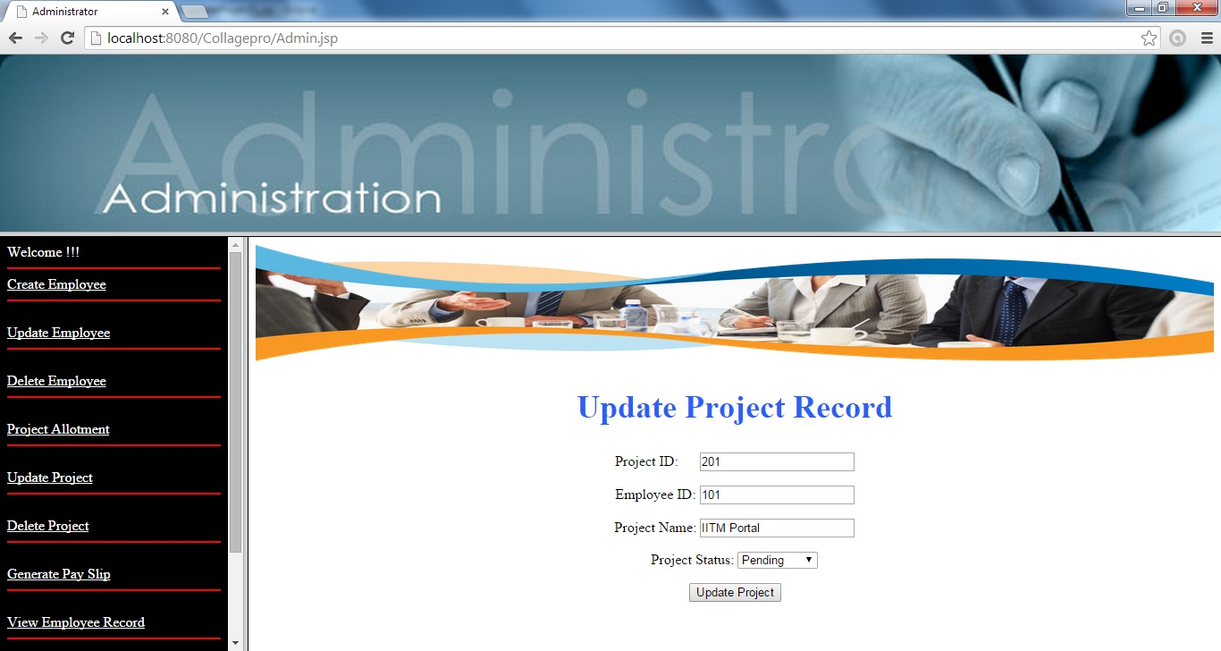
UPDATE PROJECT

Slide 27

DELETE PROJECT

Slide 28

DELETE PROJECT

Slide 29
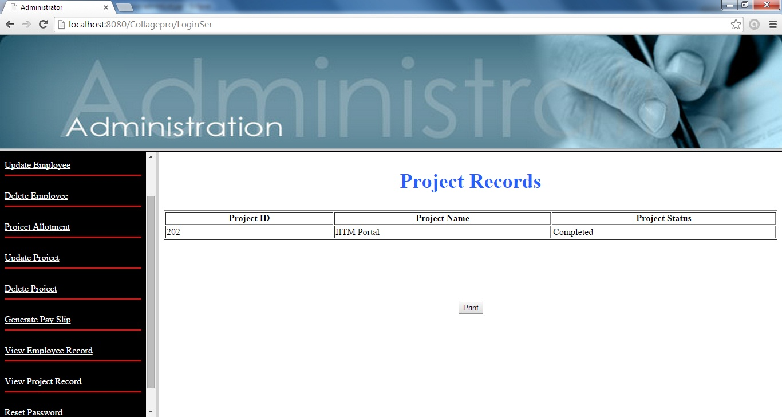
VIEW PROJECT

Slide 30
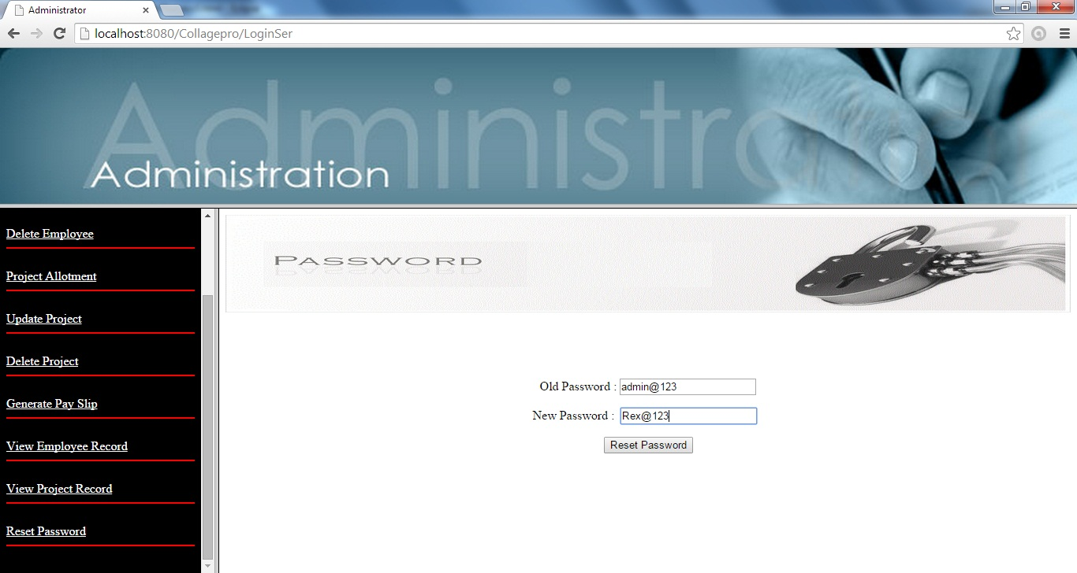
CHANGE PASSWORD

Slide 31
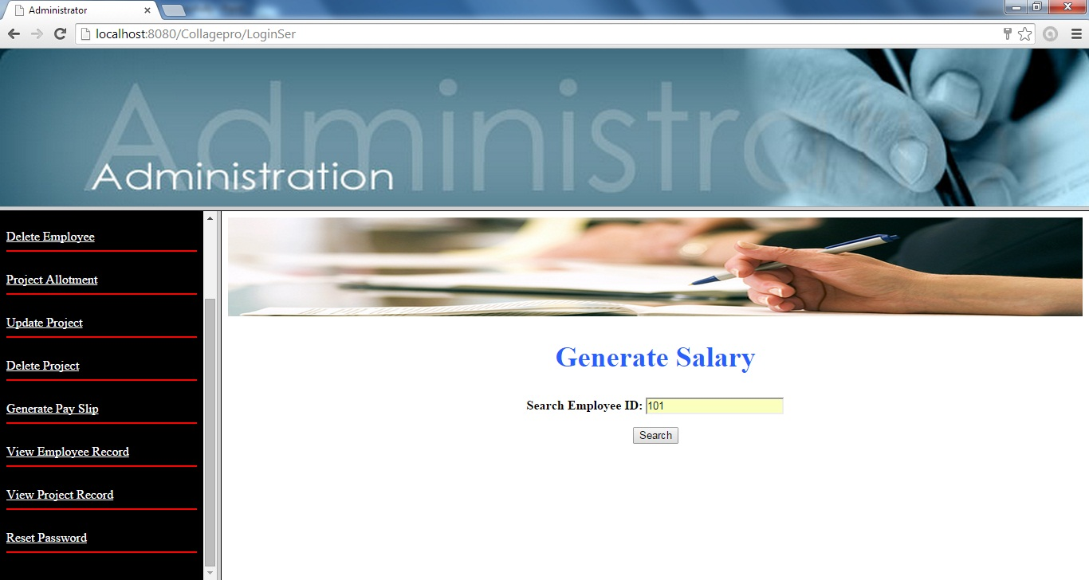
GENERATE SALARY

Slide 32
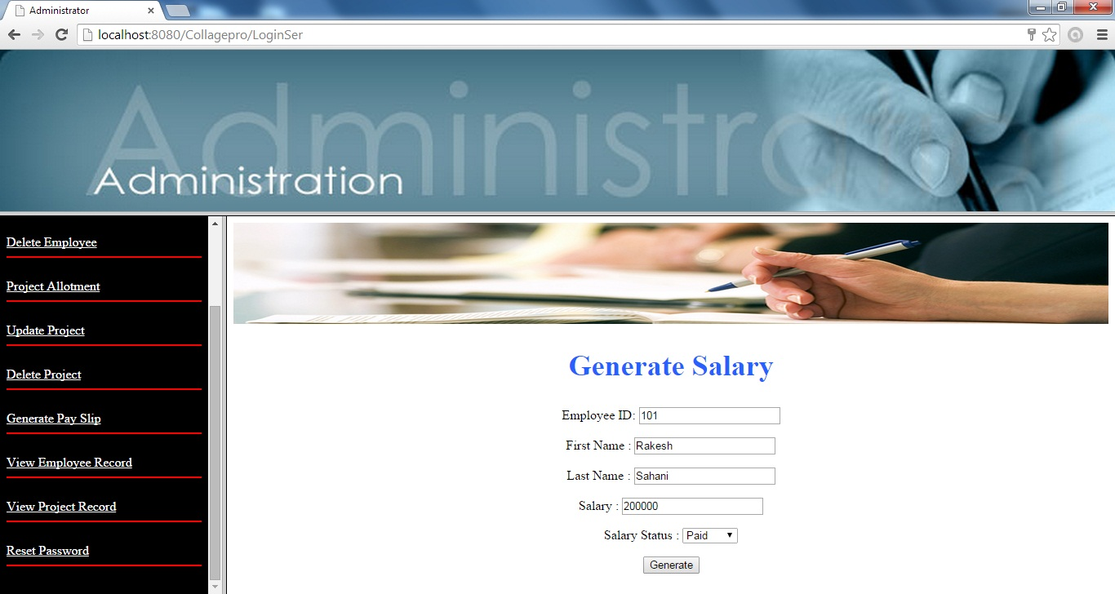
GENERATE SALARY

Slide 33
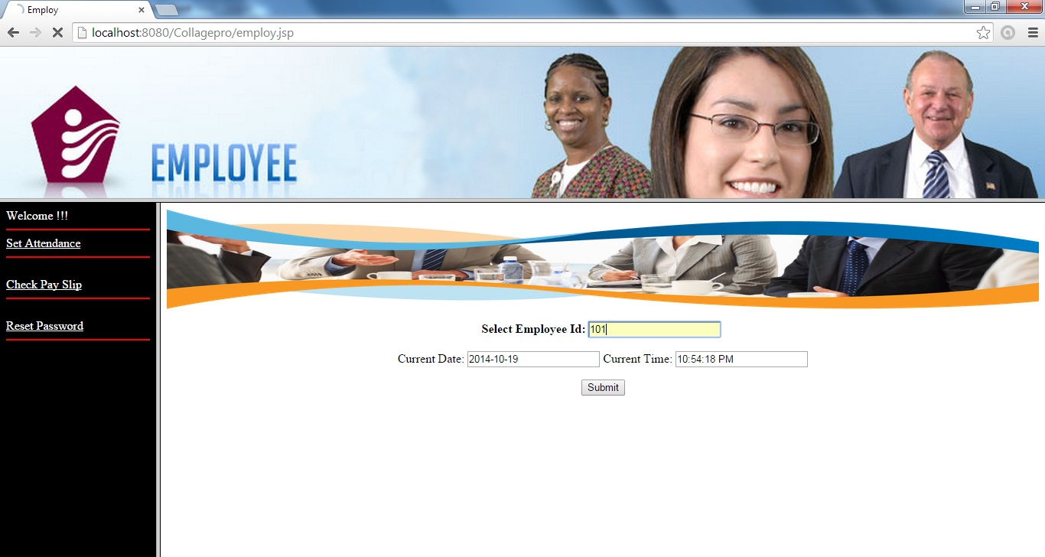
SET ATTENDENCE

Slide 34
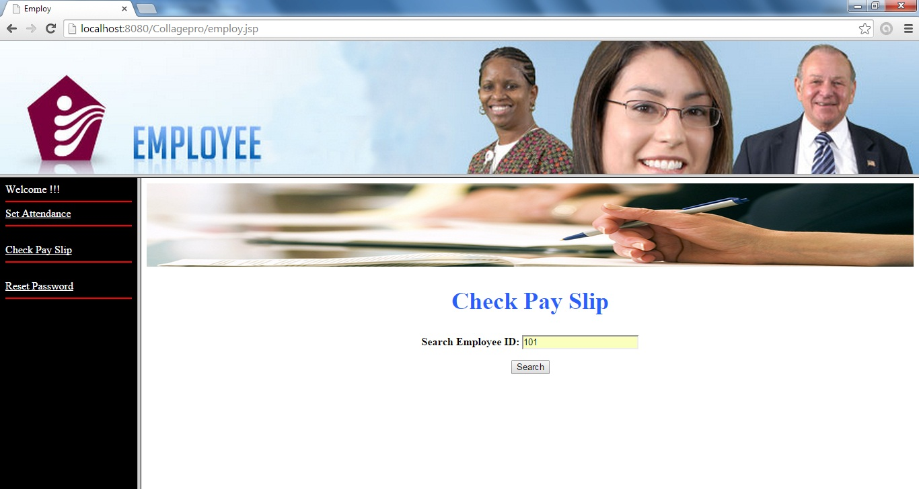
CHECK PAYSLIP

Slide 35
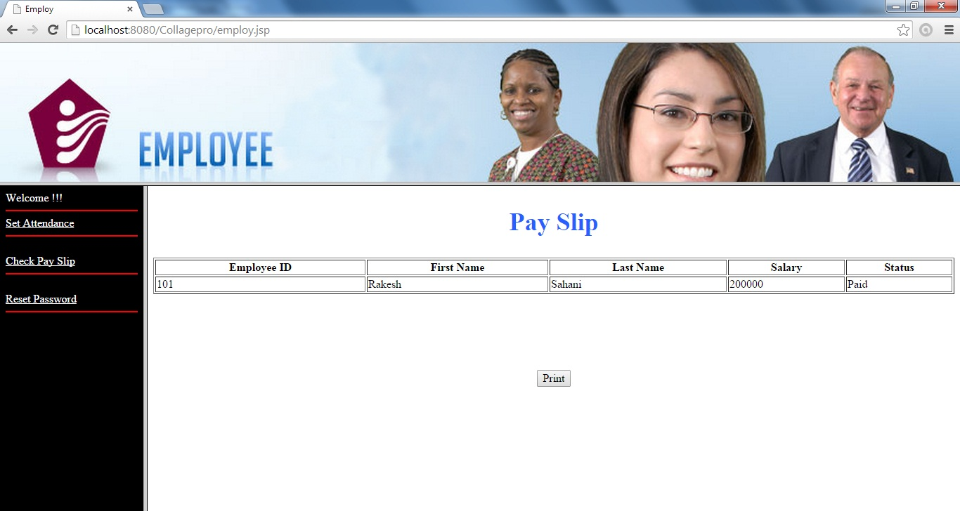
CHECK PAYSLIP

Slide 36
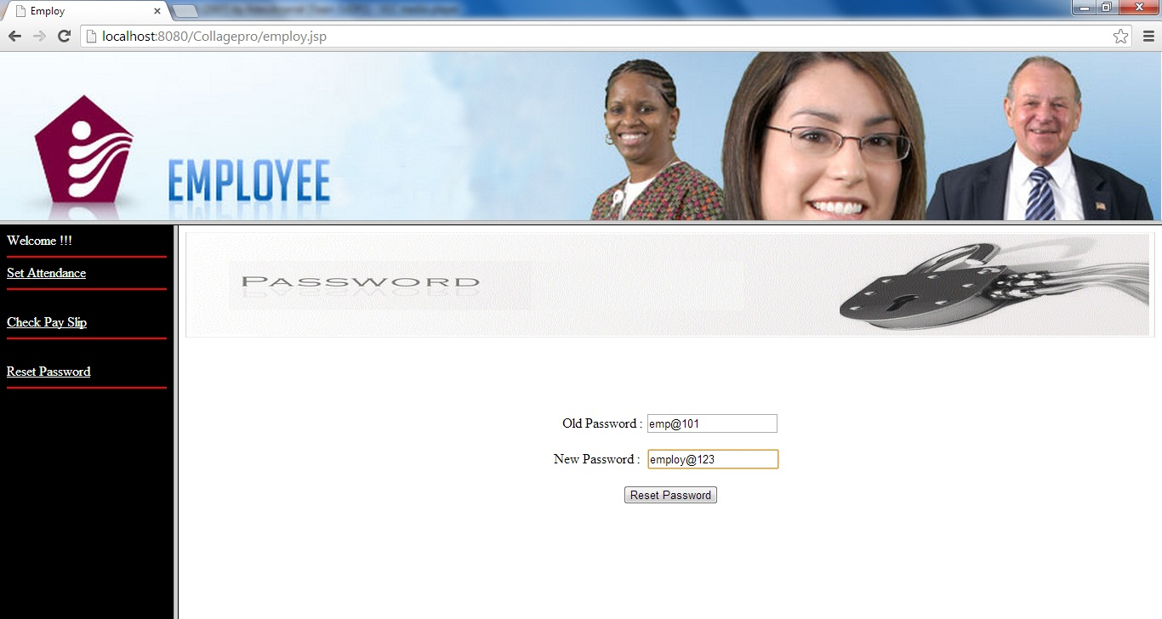
CHANGE PASSWORD

Slide 37



